Slide 1
RL Cooperative Transportation using fixed-wings drones
End of July status

Slide 2
Original Plan Formulation 1:
Action Space: λ ∈ R^{n}
Keep wrench controller and nullspace matrix. Run decentralized
𝑓 (𝑡) = 𝑓_{𝑔}(𝑡)+ 𝑓_{𝜆}(𝑡),
𝑓_{𝜆}(𝑡)= N(H,t) · λ(t)
Reward function:
Penalize ‖ṗRi‖ < ε (would be interesting to see if agent comes up with the same strategy)
Can also warm start it with Imitation learning: reward for mimicking the optimizer output
Load tracking guaranteed by construction (G·N = 0)
Doesn’t handle desynchronization
A possible extension would be adding more terms to the reward function to account for fixed-wings dynamics(e.g. minimum turning radius)
Notes:
Preferire un carattere sans serif come Arial, Helvetica o Verdana. Font consigliabile da 30 a 40 pt.
Allineare i testi a sinistra, non giustificarli.
Utilizzare non più di tre blocchi di informazione di massimo 2/3 righe ciascuno.
Per evidenziare titoli o parole chiave, prediligere l’uso del grassetto a corsivo o colori.
Prediligere testo nero su sfondo bianco.
Evitare ombre, sfumature e gradazioni di grigio.
Secondo le linee guida sull’accessibilità, prestare attenzione ai contrasti tra i colori di sfondo e il testo.

Slide 3
Original Plan Formulation 2: Residual RL
Action Space: δ𝑓 ∈ R^{3n}
Keep wrench controller and optimizer. Run decentralized
𝑓 (𝑡) = 𝑓_{𝑔}(𝑡)+ 𝑓_{𝜆}(𝑡) + δ𝑓(t)
Reward function:
Penalize load tracking error + Penalize ‖δf‖
Handles desynchronization
Stage 1: Train formulation 2
Stage 2: Remove optimizer and train formulation 1
Could also work the other way around(would be better for simulation time) or combined in one phase
Notes:
Preferire un carattere sans serif come Arial, Helvetica o Verdana. Font consigliabile da 30 a 40 pt.
Allineare i testi a sinistra, non giustificarli.
Utilizzare non più di tre blocchi di informazione di massimo 2/3 righe ciascuno.
Per evidenziare titoli o parole chiave, prediligere l’uso del grassetto a corsivo o colori.
Prediligere testo nero su sfondo bianco.
Evitare ombre, sfumature e gradazioni di grigio.
Secondo le linee guida sull’accessibilità, prestare attenzione ai contrasti tra i colori di sfondo e il testo.

Slide 4
Actual
Doing formulation 2 using the classical controller + optimizer(expert) takes very long
Because it’s decentralized the optimizer has to run 4 times per each step
Episode length of 25 seconds takes 1-2 minutes in actual runtime
Notes:
Currently I calculate it purely analytically during training (on clean states) and use a filter at deployment, this combination provided the best results, training on noise actually doesn’t make it noise resistant but makes it output more jitter
I also experimented with multiple inputs/outputs here : first I tried to output only my lambda based on measured drone state and load state. The main problem is my lambda is not enough to calculate my force
I also tried without constructing the Vr outside, without the clock features(just supply wrench for example)
The inputs and outputs that I chose in the end I think reflect the “true information” inputs and outputs of the optimizer while helping the network by doing all the analytical math outside instead of making it learn it

Slide 5
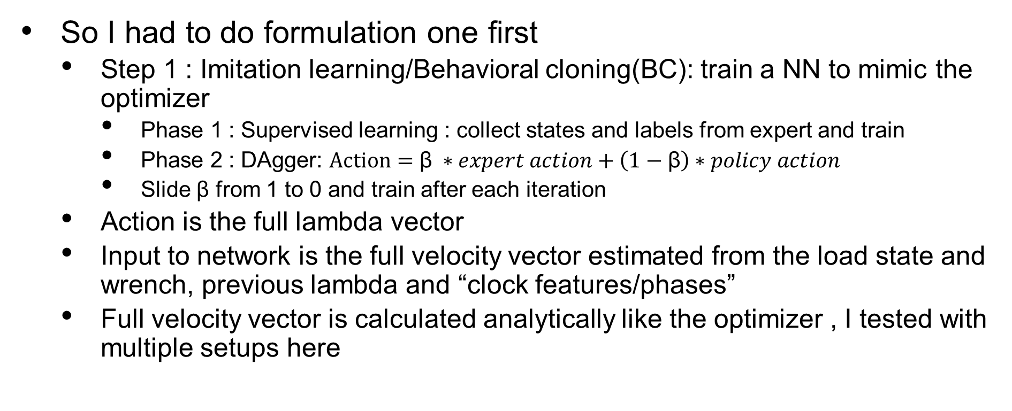
Formulation 1 status
So I had to do formulation one first
Step 1 : Imitation learning/Behavioral cloning(BC): train a NN to mimic the optimizer
Phase 1 : Supervised learning : collect states and labels from expert and train
Phase 2 : DAgger: $Action=\text{β} ∗expert action+\left(1−\text{β}\right)∗policy action$
Slide β from 1 to 0 and train after each iteration
Action is the full lambda vector
Input to network is the full velocity vector estimated from the load state and wrench, previous lambda and “clock features/phases”
Full velocity vector is calculated analytically like the optimizer , I tested with multiple setups here
Notes:
Currently I calculate it purely analytically during training (on clean states) and use a filter at deployment, this combination provided the best results, training on noise actually doesn’t make it noise resistant but makes it output more jitter
I also experimented with multiple inputs/outputs here : first I tried to output only my lambda based on measured drone state and load state. The main problem is my lambda is not enough to calculate my force
I also tried without constructing the Vr outside, without the clock features(just supply wrench for example)
The inputs and outputs that I chose in the end I think reflect the “true information” inputs and outputs of the optimizer while helping the network by doing all the analytical math outside instead of making it learn it

Slide 6
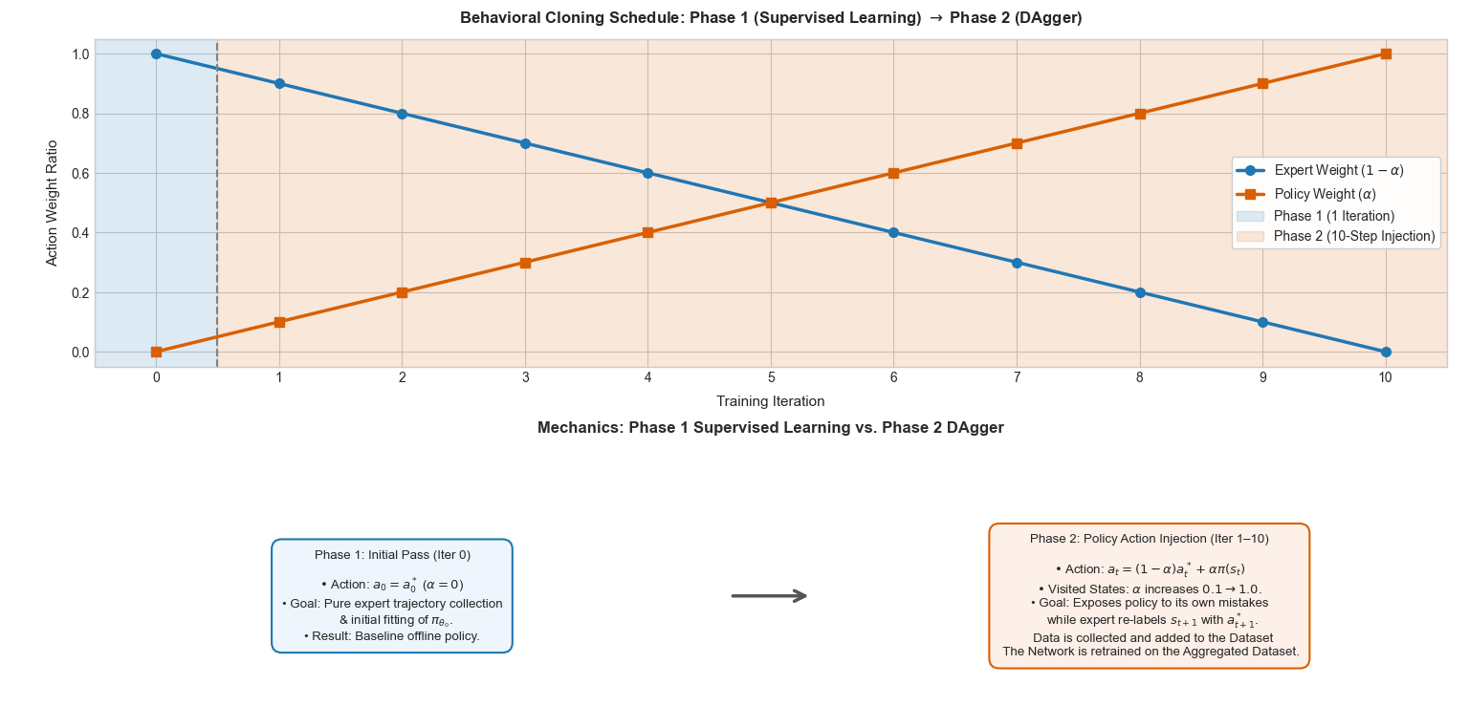
Notes:
Currently I calculate it purely analytically during training (on clean states) and use a filter at deployment, this combination provided the best results, training on noise actually doesn’t make it noise resistant but makes it output more jitter
I also experimented with multiple inputs/outputs here : first I tried to output only my lambda based on measured drone state and load state. The main problem is my lambda is not enough to calculate my force
I also tried without constructing the Vr outside, without the clock features(just supply wrench for example)
The inputs and outputs that I chose in the end I think reflect the “true information” inputs and outputs of the optimizer while helping the network by doing all the analytical math outside instead of making it learn it

Slide 7
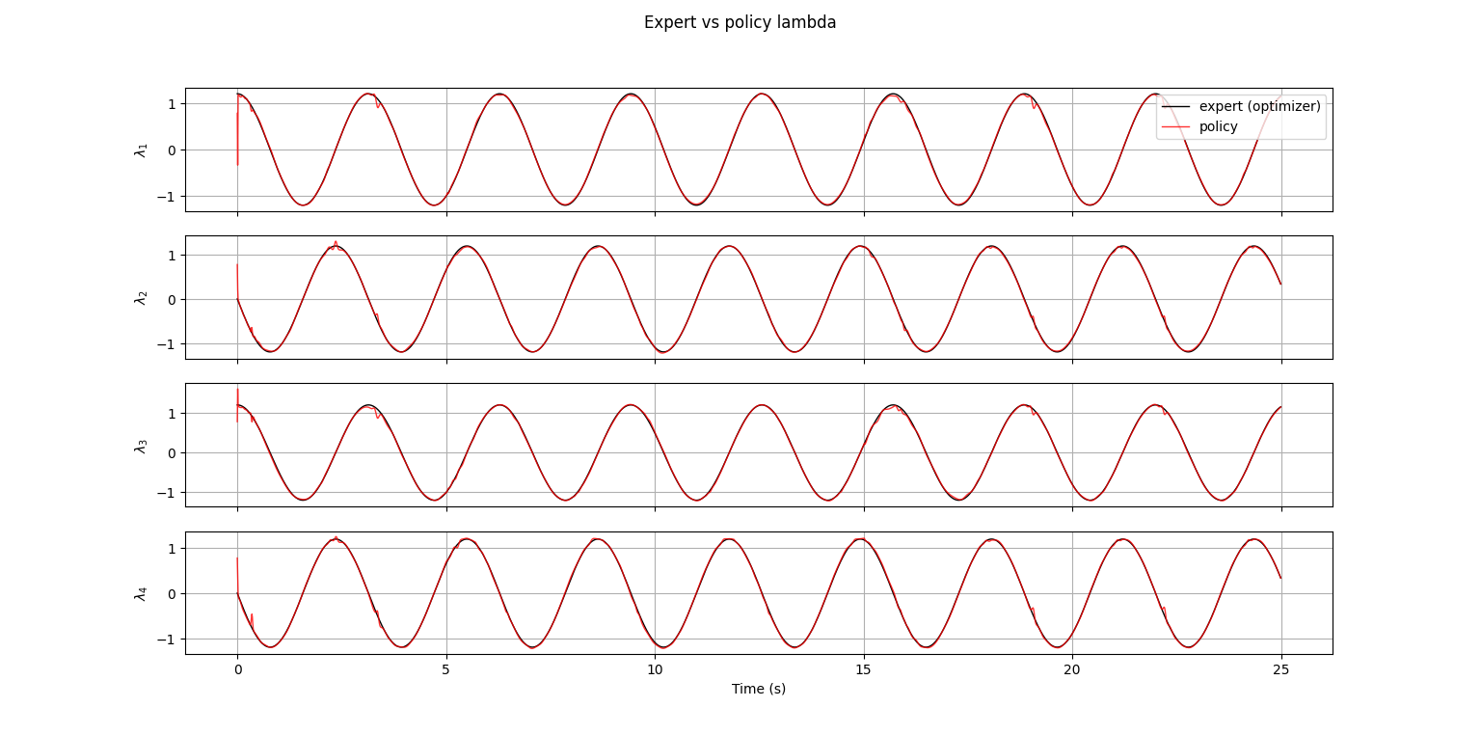
Formulation 1 status
Notes:
Currently I calculate it purely analytically during training (on clean states) and use a filter at deployment, this combination provided the best results, training on noise actually doesn’t make it noise resistant but makes it output more jitter
I also experimented with multiple inputs/outputs here : first I tried to output only my lambda based on measured drone state and load state. The main problem is my lambda is not enough to calculate my force
I also tried without constructing the Vr outside, without the clock features(just supply wrench for example)
The inputs and outputs that I chose in the end I think reflect the “true information” inputs and outputs of the optimizer while helping the network by doing all the analytical math outside instead of making it learn it
*From looking at the behavior of the network so far

Slide 8
Formulation 1 status
Flying with the policy alone is successful
So far BC with DAgger alone is producing acceptable results
Episode length of 25 seconds takes ~ 7 seconds in actual runtime(10x faster)
I trained on limited trajectories, so generalization still needs to be done
As we generalize and add noise, RL becomes necessary
RL objective regularized(TRPO relaxed-like) or just normal warm starting​.
Reward function design strategy:
Study/analyze the failure modes of BC alone and choose a reward function that fights it
It will have to do with jittering and non smooth movement in general*(similar to optimizer). R = - w_lam * sum_i (lam_i_t - lam_i_prev)^2
Notes:
Currently I calculate it purely analytically during training (on clean states) and use a filter at deployment, this combination provided the best results, training on noise actually doesn’t make it noise resistant but makes it output more jitter
I also experimented with multiple inputs/outputs here : first I tried to output only my lambda based on measured drone state and load state. The main problem is my lambda is not enough to calculate my force
I also tried without constructing the Vr outside, without the clock features(just supply wrench for example)
The inputs and outputs that I chose in the end I think reflect the “true information” inputs and outputs of the optimizer while helping the network by doing all the analytical math outside instead of making it learn it
*From looking at the behavior of the network so far

Slide 9
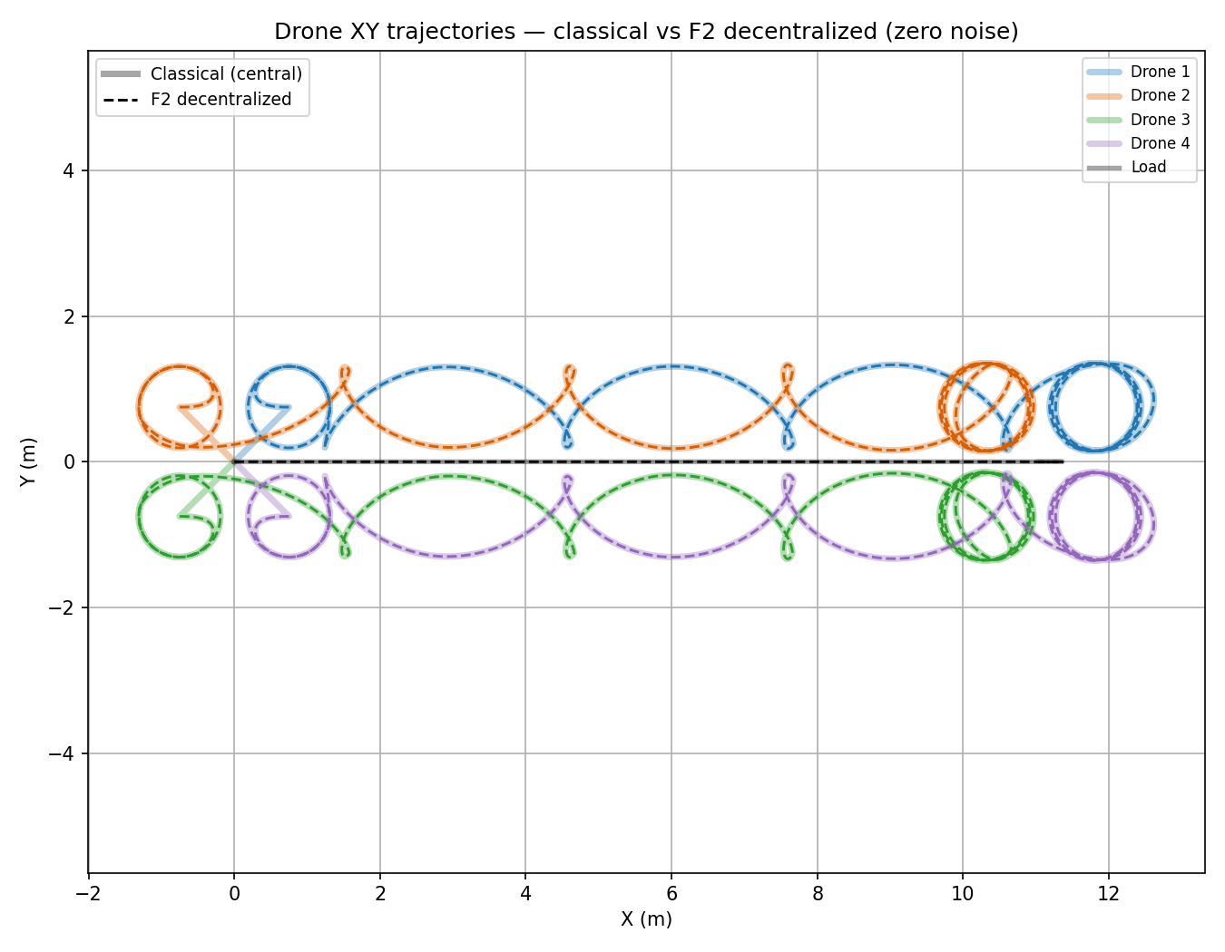
Notes:
Currently I calculate it purely analytically during training (on clean states) and use a filter at deployment, this combination provided the best results, training on noise actually doesn’t make it noise resistant but makes it output more jitter
I also experimented with multiple inputs/outputs here : first I tried to output only my lambda based on measured drone state and load state. The main problem is my lambda is not enough to calculate my force
I also tried without constructing the Vr outside, without the clock features(just supply wrench for example)
The inputs and outputs that I chose in the end I think reflect the “true information” inputs and outputs of the optimizer while helping the network by doing all the analytical math outside instead of making it learn it
*From looking at the behavior of the network so far

Slide 10
Formulation 2 status
Currently I’m injecting noise in the load state and delay in some drones’ clocks
BC with DAgger alone completely failing(not sure if it’s even helping)
Still analyzing failure modes to try and design a good reward function
Load tracking as a reward struggles due to the decoupling of drone trajectories and load trajectory
A good reward would encourage the drones to be close to a mathematical description of the de-noised loitering
Notes:
Currently I calculate it purely analytically during training (on clean states) and use a filter at deployment, this combination provided the best results, training on noise actually doesn’t make it noise resistant but makes it output more jitter
I also experimented with multiple inputs/outputs here : first I tried to output only my lambda based on measured drone state and load state. The main problem is my lambda is not enough to calculate my force
I also tried without constructing the Vr outside, without the clock features(just supply wrench for example)
The inputs and outputs that I chose in the end I think reflect the “true information” inputs and outputs of the optimizer while helping the network by doing all the analytical math outside instead of making it learn it
*From looking at the behavior of the network so far

Slide 11
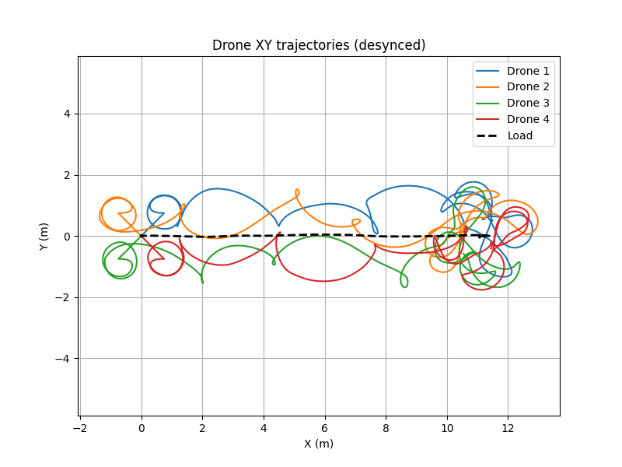
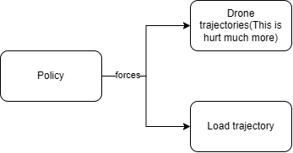
Notes:
Currently I calculate it purely analytically during training (on clean states) and use a filter at deployment, this combination provided the best results, training on noise actually doesn’t make it noise resistant but makes it output more jitter
I also experimented with multiple inputs/outputs here : first I tried to output only my lambda based on measured drone state and load state. The main problem is my lambda is not enough to calculate my force
I also tried without constructing the Vr outside, without the clock features(just supply wrench for example)
The inputs and outputs that I chose in the end I think reflect the “true information” inputs and outputs of the optimizer while helping the network by doing all the analytical math outside instead of making it learn it
*From looking at the behavior of the network so far

Slide 12
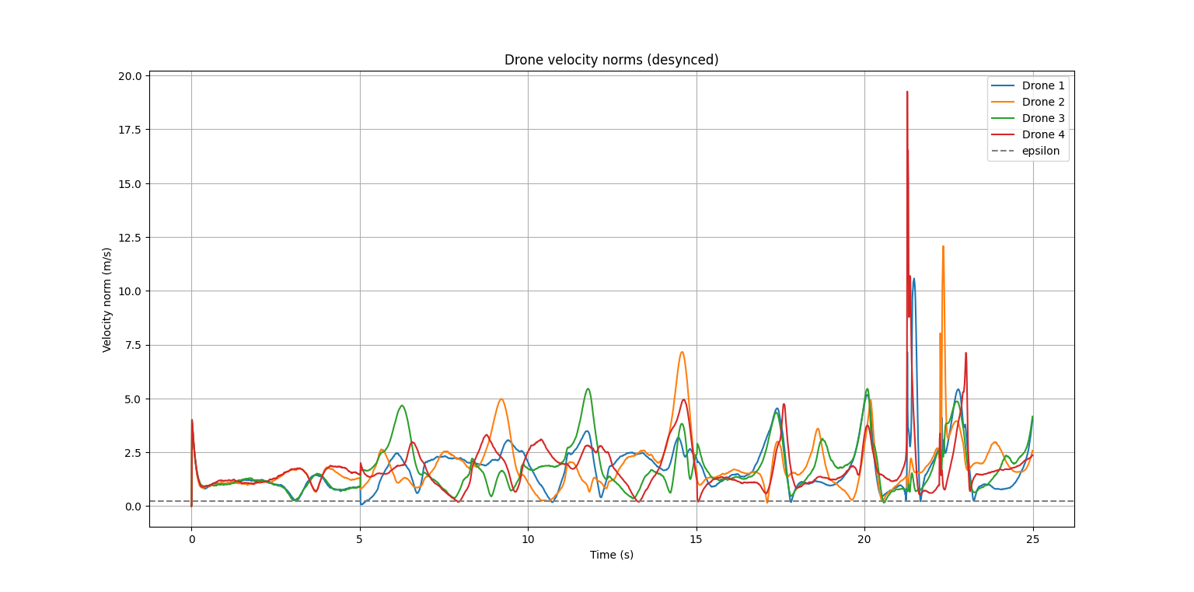
Notes:
Currently I calculate it purely analytically during training (on clean states) and use a filter at deployment, this combination provided the best results, training on noise actually doesn’t make it noise resistant but makes it output more jitter
I also experimented with multiple inputs/outputs here : first I tried to output only my lambda based on measured drone state and load state. The main problem is my lambda is not enough to calculate my force
I also tried without constructing the Vr outside, without the clock features(just supply wrench for example)
The inputs and outputs that I chose in the end I think reflect the “true information” inputs and outputs of the optimizer while helping the network by doing all the analytical math outside instead of making it learn it
*From looking at the behavior of the network so far

Slide 13
Università degli Studi di Padova

